Slide 1
Chapter 8
Bonding: General
Concepts

Slide 2
8.1 Types of Chemical Bonds
8.3 Bond Polarity and Dipole Moments
8.5 Energy Effects in Binary Ionic Compounds
8.6 Partial Ionic Character of Covalent Bonds
8.7 The Covalent Chemical Bond: A Model
8.8 Covalent Bond Energies and Chemical Reactions
8.9 The Localized Electron Bonding Model
8.10 Lewis Structures
8.11 Exceptions to the Octet Rule
8.12 Resonance
8.13 Molecular Structure: The VSEPR Model

Slide 3
A Chemical Bond
No simple, and yet complete, way to define this.
Forces that hold groups of atoms together and make them function as a unit.
A bond will form if the energy of the aggregate is lower than that of the separated atoms.

Slide 4
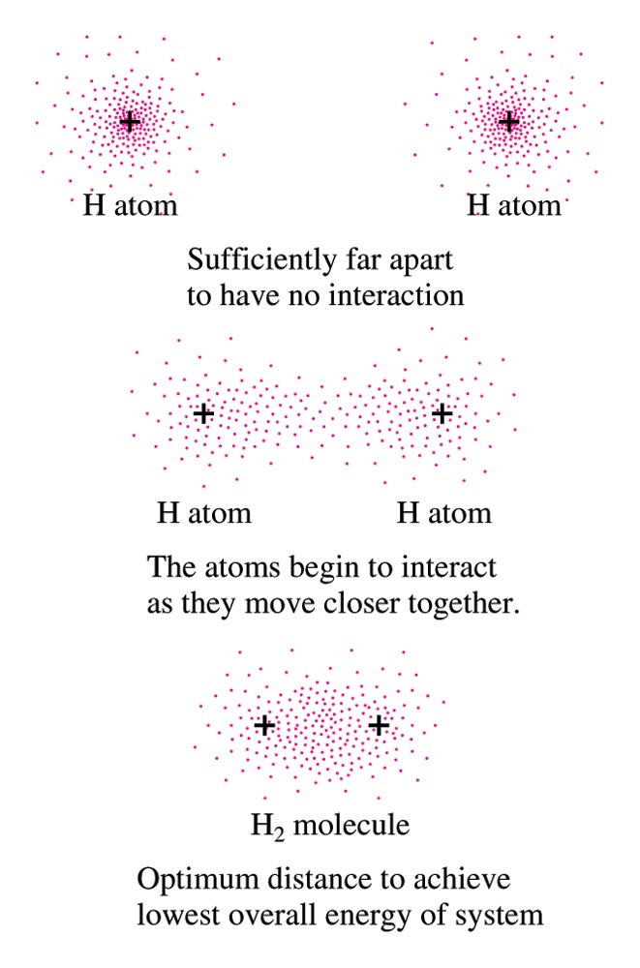
The Interaction of Two Hydrogen Atoms

Slide 5
Key Ideas in Bonding
Ionic Bonding – electrons are transferred
Covalent Bonding – electrons are shared equally
What about intermediate cases?

Slide 6
Polar Covalent Bond
Unequal sharing of electrons between atoms in a molecule.
Results in a charge separation in the bond (partial positive and partial negative charge).

Slide 7

Polar Molecules

Slide 8
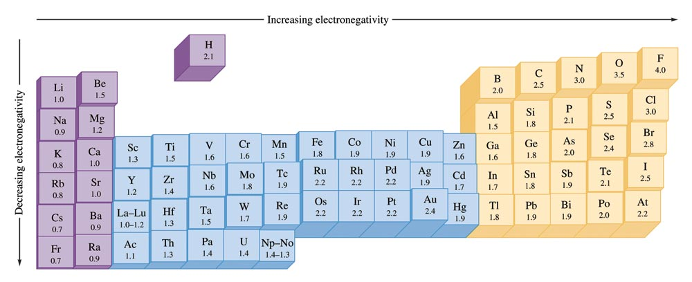
The Pauling Electronegativity Values

Slide 9
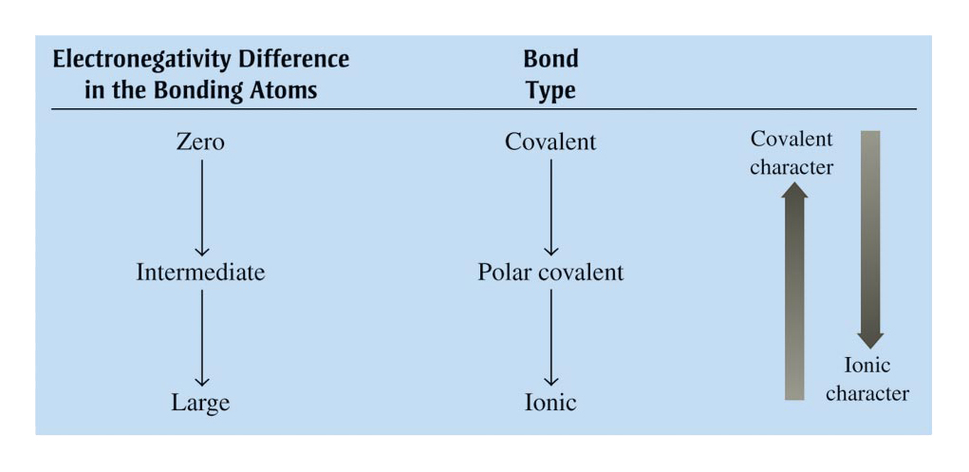
The Relationship Between Electronegativity and Bond Type

Slide 10

Exercise
Arrange the following bonds from most to least polar:
a) N–F O–F C–F
a) C–F, N–F, O–F
b) C–F N–O Si–F
b) Si–F, C–F, N–O
c) Cl–Cl B–Cl S–Cl
c) B–Cl, S–Cl, Cl–Cl
Notes:
The greater the electronegativity difference between the atoms, the more polar the bond.
C-F, N-F, O-F
Si-F, C-F, N-O
B-Cl, S-Cl, Cl-Cl

Slide 11
Dipole Moment
Property of a molecule whose charge distribution can be represented by a center of positive charge and a center of negative charge.
Use an arrow to represent a dipole moment.
  Point to the negative charge center with the tail of the arrow indicating the positive center of charge.

Slide 12
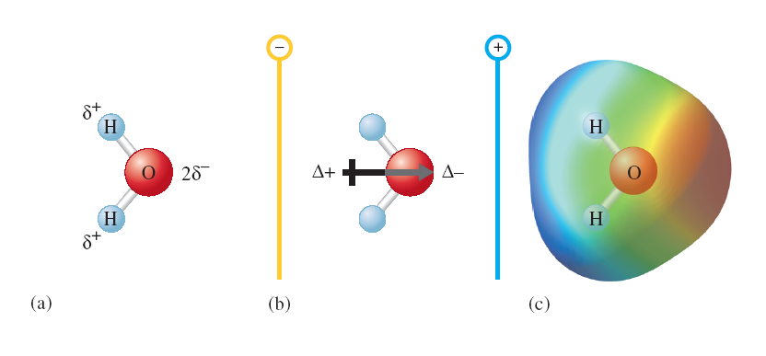
Dipole Moment

Slide 13
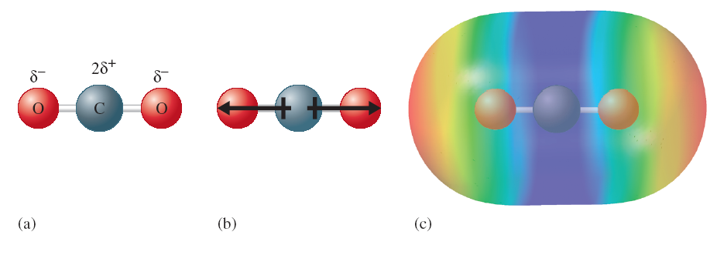
No Net Dipole Moment (Dipoles Cancel)

Slide 14
Which of the following molecules have a dipole moment?
H₂O, CO₂, SO₂, and CH₄
O
S
H
H
O
O
dipole moment
polar molecule
dipole moment
polar molecule
H
H
C
H
O
C
O
no dipole moment
nonpolar molecule
H
no dipole moment
nonpolar molecule
10.2

Slide 15
Electron Configurations in Stable Compounds
Two nonmetals form a covalent bond by sharing electrons to complete the valence electron configurations of both atoms.
A metal and a nonmetal form ions by emptying the valence orbitals of the metal and adding electrons to the nonmetal to gain a noble gas configuration. These ions then form a binary ionic compound.

Slide 16
Lattice Energy
The change in energy that takes place when separated gaseous ions are packed together to form an ionic solid.
k = proportionality constant
Q₁ and Q₂ = charges on the ions ** affects size
r = shortest distance between the centers of the cations and anions

Slide 17

Born-Haber Cycle for NaCl

Slide 18
Formation of an Ionic Solid
Lattice Energy problems must always be done for a single atom in the gas state – and be sure to know the SIGN of each
1. Convert to gas phase if needed (for solids… Sublimation of the solid metal.)
  M(s) → M(g) [endothermic (+)]
2. Ionization Energy of the metal atoms. (may need to add 1st IE, 2nd IE, etc.)
  M(g) → M⁺(g) + e⁻ [endothermic (+)]
3. Dissociation of the nonmetal if needed.
  ¹/2X₂(g) → X(g) [endothermic (+)]

Slide 19
Formation of an Ionic Solid (continued)
4. Electron Affinity for Formation of X⁻ ions in the gas phase.
  X(g) + e⁻ → X⁻(g) [exothermic (-)]
5. Lattice Energy for Formation of the solid MX.
  M⁺(g) + X⁻(g) → MX(s)
  [quite exothermic (-)]

Slide 20
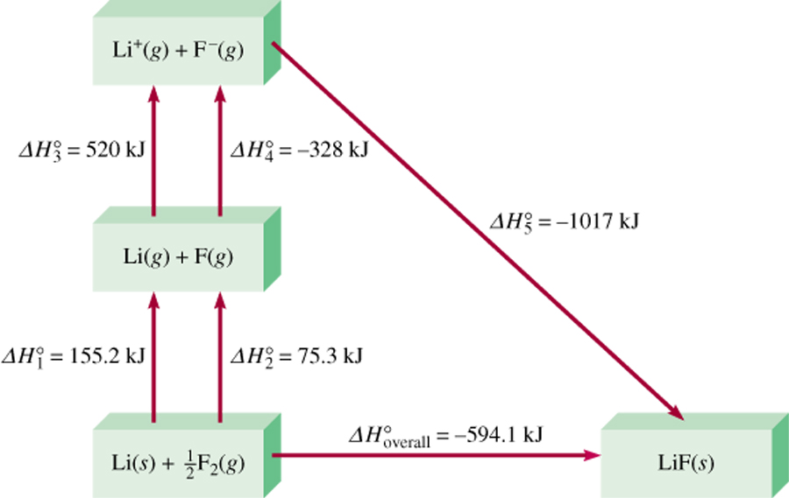
Born-Haber Cycle for Determining Lattice Energy
o
o
o
o
o
o
ΔH_{overall} = ΔH₁ + ΔH₂ + ΔH₃ + ΔH₄ + ΔH₅
9.3

Slide 21
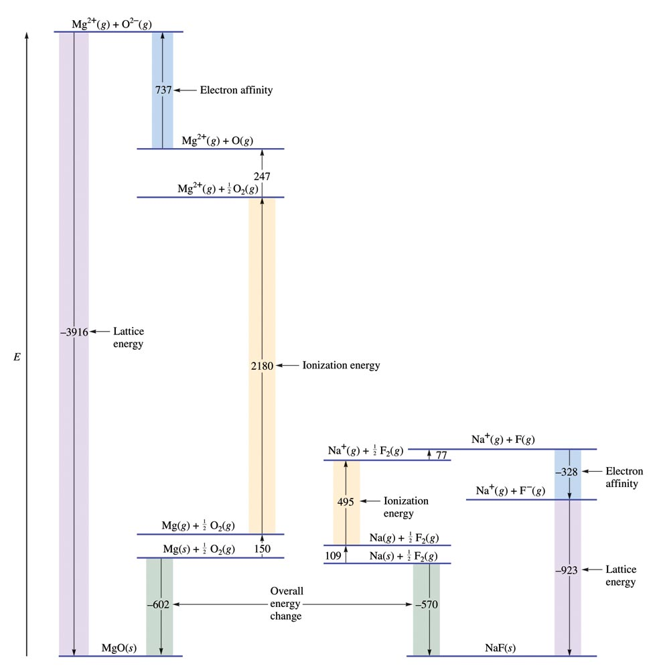
Comparing Energy Changes

Slide 22
Bond Energies
To break bonds, energy must be added to the system (endothermic).
To form bonds, energy is released (exothermic).

Slide 23
Bond Energies
ΔH = Σn×D(bonds broken) – Σn×D(bonds formed)
D represents the bond energy per mole of bonds (always has a positive sign).

Slide 24
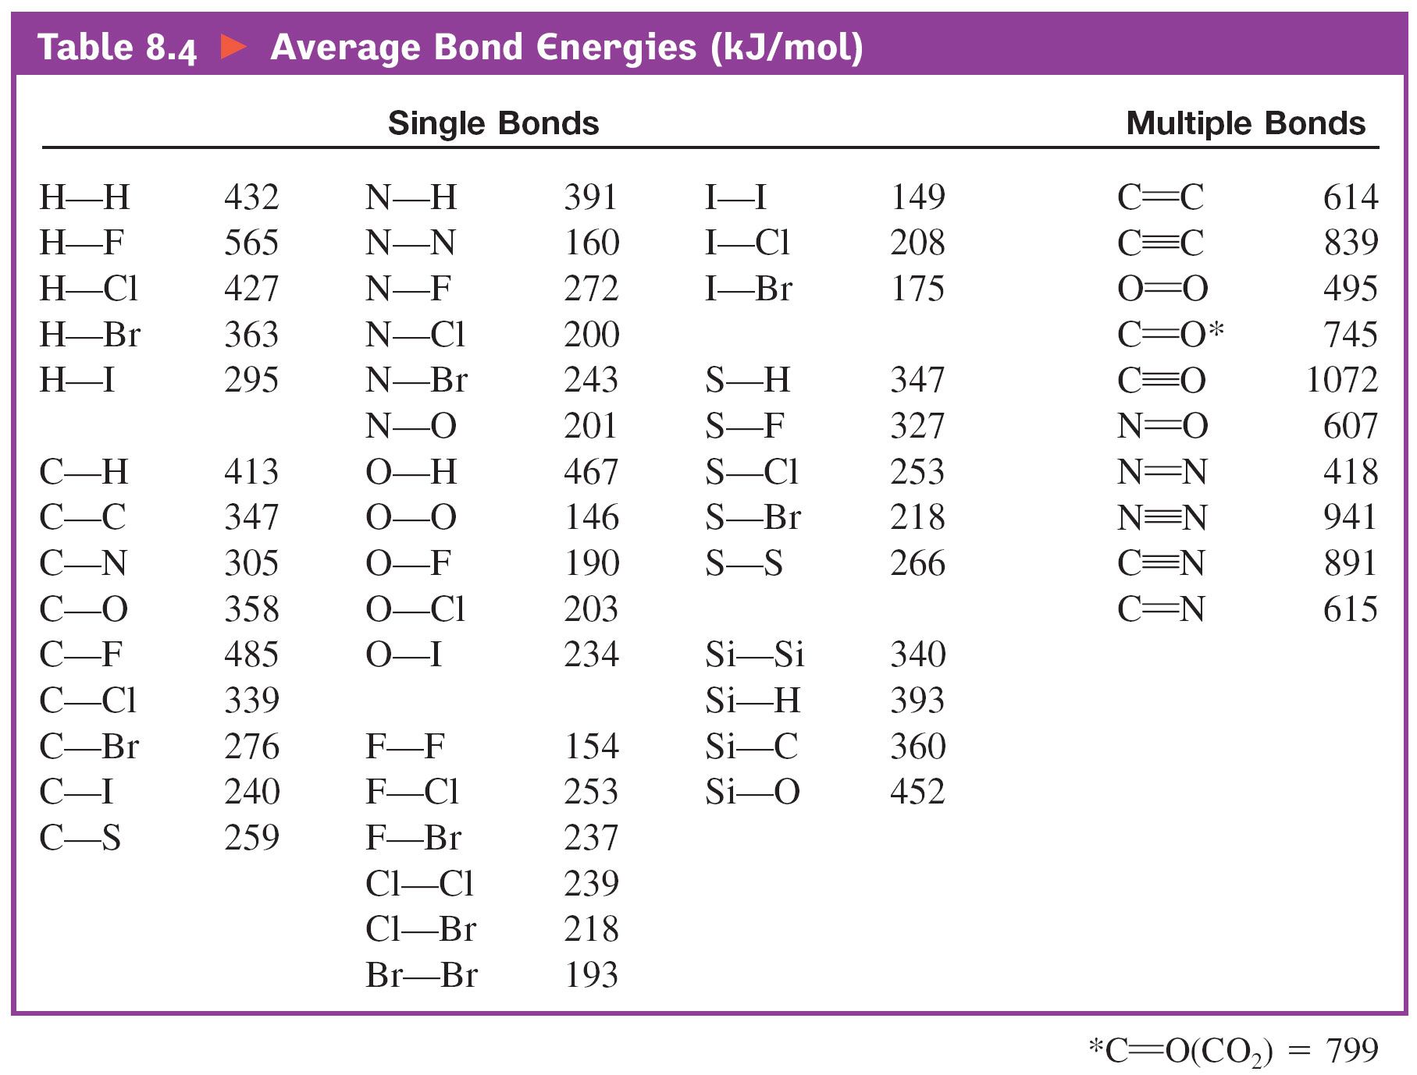
Average Bond Energies

Slide 25
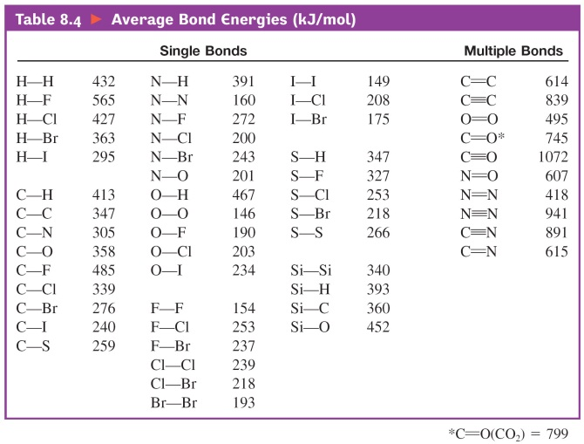
The enthalpy change required to break a particular bond in one mole of gaseous molecules is the bond energy.
Bond Energy
H_{2 (g)}
H _{(g)}
+
H _{(g)}
ΔH0 = 432 kJ
Cl_{2 (g)}
Cl _{(g)}
+
Cl _{(g)}
ΔH0 = 239 kJ
HCl _{(g)}
H _{(g)}
+
Cl _{(g)}
ΔH0 = 427 kJ
O_{2 (g)}
O _{(g)}
+
O _{(g)}
ΔH0 = 495 kJ
O
O
N_{2 (g)}
N _{(g)}
+
N _{(g)}
ΔH0 = 943 kJ
N
N
Bond Energies
Single bond < Double bond < Triple bond
9.10

Slide 26
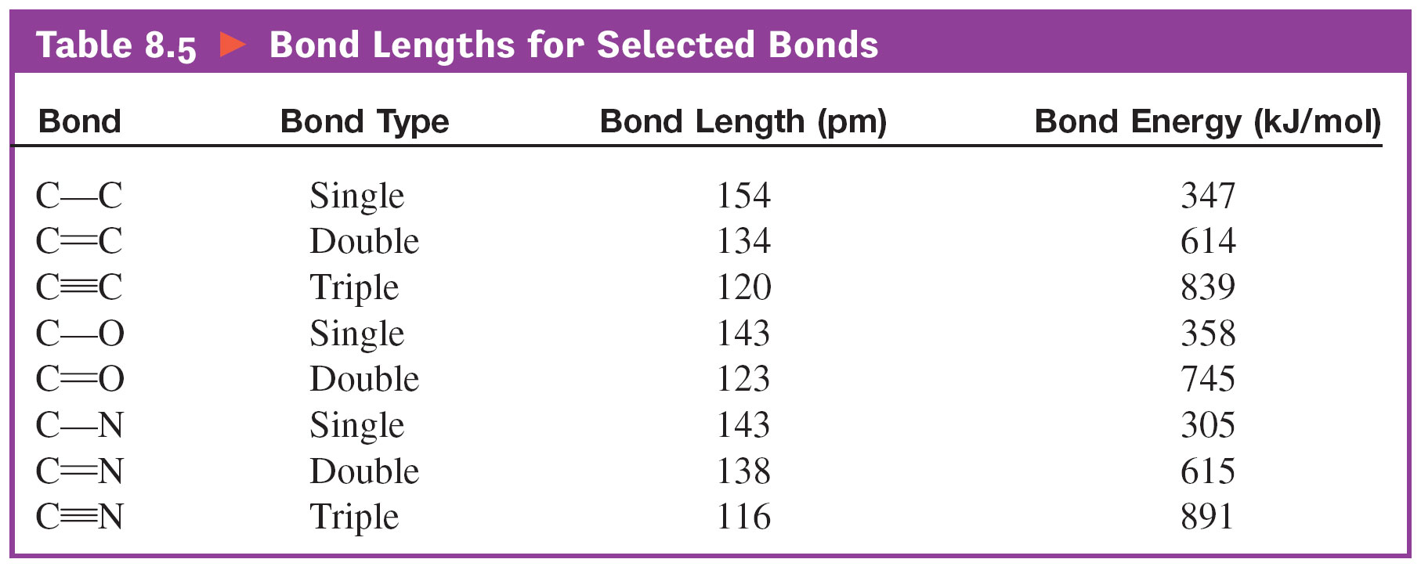
Bond Lengths for Selected Bonds

Slide 27
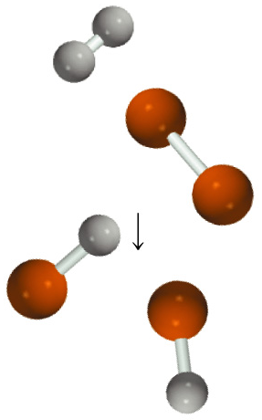
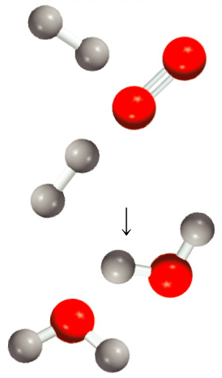
H₂ (g) + Cl₂ (g) 2HCl (g)
2H₂ (g) + O₂ (g) 2H₂O (g)
9.10

Slide 28
Use bond energies to calculate the enthalpy change for:
H_{2 (g)} + F_{2 (g)} 2HF _{(g)}
ΔH0 = ΣBE(reactants) – ΣBE(products)
Type of bonds broken
Number of bonds broken
Bond energy (kJ/mol)
Energy change (kJ)
H
H
1
432
432
F
F
1
154
154
Type of bonds formed
Number of bonds formed
Bond energy (kJ/mol)
Energy change (kJ)
H
F
2
565
1130
ΔH0 = 432 + 154 – (2 x 565) = -544 kJ
9.10

Slide 29
Exercise
Predict ΔH for the following reaction:
Given the following information:
Bond Energy (kJ/mol)
C–H 413
C–N 305
C–C 347
891
ΔH = –42 kJ
Notes:
[3(413) + 305 + 891] – [3(413) + 347 + 891] = –42 kJ
ΔH = –42 kJ

Slide 30
Models
Models are attempts to explain how nature operates on the microscopic level based on experiences in the macroscopic world.

Slide 31
Fundamental Properties of Models
A model does not equal reality.
Models are oversimplifications, and are therefore often wrong.
Models become more complicated and are modified as they age.
We must understand the underlying assumptions in a model so that we don’t misuse it.
When a model is wrong, we often learn much more than when it is right.

Slide 32
Localized Electron Model
A molecule is composed of atoms that are bound together by sharing pairs of electrons using the atomic orbitals of the bound atoms.

Slide 33
Localized Electron Model
Electron pairs are assumed to be localized on a particular atom or in the space between two atoms:
  Lone pairs – pairs of electrons localized on an atom
  Bonding pairs – pairs of electrons found in the space between the atoms

Slide 34
Localized Electron Model
Description of valence electron arrangement (Lewis structure).
Prediction of geometry (VSEPR model).
Description of atomic orbital types used to share electrons or hold lone pairs.

Slide 35
Lewis Structure
Shows how valence electrons are arranged among atoms in a molecule.
Reflects central idea that stability of a compound relates to noble gas electron configuration.

Slide 36
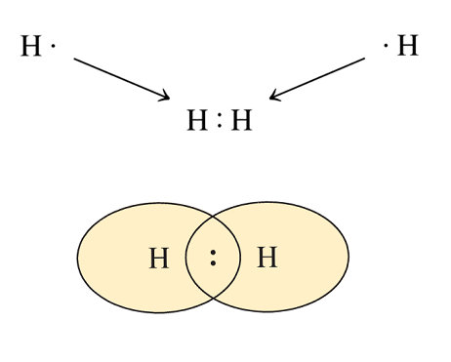
Duet Rule
Hydrogen forms stable molecules where it shares two electrons.

Slide 37
Octet Rule
Elements form stable molecules when surrounded by eight electrons.

Slide 38
Steps for Writing Lewis Structures
Sum the valence electrons from all the atoms.
Use a pair of electrons to form a bond between each pair of bound atoms.
Atoms usually have noble gas configurations. Arrange the remaining electrons to satisfy the octet rule (or duet rule for hydrogen).

Slide 39
Steps for Writing Lewis Structures
Sum the valence electrons from all the atoms. (Use the periodic table.)
Example: H₂O
2 (1 e–) + 6 e– = 8 e– total

Slide 40
Steps for Writing Lewis Structures
Use a pair of electrons to form a bond between each pair of bound atoms.
  Example: H₂O

Slide 41
Steps for Writing Lewis Structures
Atoms usually have noble gas configurations. Arrange the remaining electrons to satisfy the octet rule (or duet rule for hydrogen).
Examples: H₂O, PBr₃, and HCN

Slide 42

Concept Check
Draw a Lewis structure for each of the following molecules:
NH₃
CO₂
CCl₄

Slide 43
Boron tends to form compounds in which the boron atom has fewer than eight electrons around it (it does not have a complete octet).
BH₃ = 6e–

Slide 44
When it is necessary to exceed the octet rule for one of several third-row (or higher) elements, place the extra electrons on the central atom.
SF₄ = 34e– AsBr₅ = 40e–

Slide 45
Violations of the Octet Rule
Usually occurs with B and elements of higher periods and most nonmetals. Common exceptions are: Be, B, P, S, Xe, Cl, Br, and As.
How do you know if it’s an EXPANDED octet?
  More valence electrons than the initial drawing
  More than 4 bonds
  Formal Charge doesn’t work out
  with just 8
Expanded
P: 8 OR 10
S: 8, 10, OR 12
Xe: 8, 10, OR 12
Incomplete
Be: 4
B: 6
BF₃
SF₄

Slide 46
Concept Check
Draw a Lewis structure for each of the following molecules:
BF₃
PCl₅
SF₆

Slide 47
Let’s Review
C, N, O, and F should always be assumed to obey the octet rule.
B and Be often have fewer than 8 electrons around them in their compounds.
Second-row elements never exceed the octet rule.
Third-row and heavier elements often satisfy the octet rule but can exceed the octet rule by using their empty valence d orbitals.

Slide 48
Let’s Review
When writing the Lewis structure for a molecule, satisfy the octet rule for the atoms first. If electrons remain after the octet rule has been satisfied, then place them on the elements having available d orbitals (elements in Period 3 or beyond).

Slide 49
Formal Charge
Used to evaluate nonequivalent Lewis structures to find the best structure
Atoms in molecules try to achieve formal charges as close to zero as possible.
Any negative formal charges are expected to reside on the most electronegative atoms.
formal charge on an atom in a Lewis structure
total number of valence electrons in the free atom
total number of nonbonding electrons
(
total number of bonding electrons
1
)
=
-
-
2

Slide 50
Concept Check
Consider the Lewis structure for POCl₃. Assign the formal charge for each atom in the molecule.
P: 5 – 0 – ½ (8) = +1
O: 6 – 6 – ½ (2) = –1
Cl: 7 – 6 – ½ (2) = 0
Notes:
P: 5 – 4 = +1
O: 6 – 7 = -1
Cl: 7 – 7 = 0

Slide 51
Rules Governing Formal Charge
The sum of the formal charges of all atoms in a given molecule or ion must equal the overall charge on that species.

Slide 52
Rules Governing Formal Charge
If nonequivalent Lewis structures exist for a species, those with formal charges closest to zero and with any negative formal charges on the most electronegative atoms are considered to best describe the bonding in the molecule or ion.

Slide 53
Concept Check
Draw the best structure for the anion: thiocyanate.

Slide 54
When more than one valid Lewis structure can be written for a particular molecule (equivalent structures)
NO₃– = 24e–

Slide 55
Actual structure is an average of the resonance structures.
Electrons are really delocalized – they can move around the entire molecule. ATOMS do not move!

Slide 56
Concept Check
Draw a Lewis structure for each of the following molecules:
CO CO₂
CH₃OH OCN–

Slide 57
VSEPR Model
VSEPR: Valence Shell Electron-Pair Repulsion.
The structure around a given atom is determined principally by minimizing electron pair repulsions.

Slide 58
Steps to Apply the VSEPR Model
Draw the Lewis structure for the molecule.
Count the electron pairs and arrange them in the way that minimizes repulsion (put the pairs as far apart as possible.
Determine the positions of the atoms from the way electron pairs are shared (how electrons are shared between the central atom and surrounding atoms).
Determine the name of the molecular structure from positions of the atoms.

Slide 59
VSEPR

Slide 60
VSEPR: Two Electron Pairs

Slide 61
VSEPR: Three Electron Pairs

Slide 62
VSEPR: Four Electron Pairs

Slide 63

VSEPR: Iodine Pentafluoride

Slide 64
Arrangements of Electron Pairs Around an Atom Yielding Minimum Repulsion

Slide 65
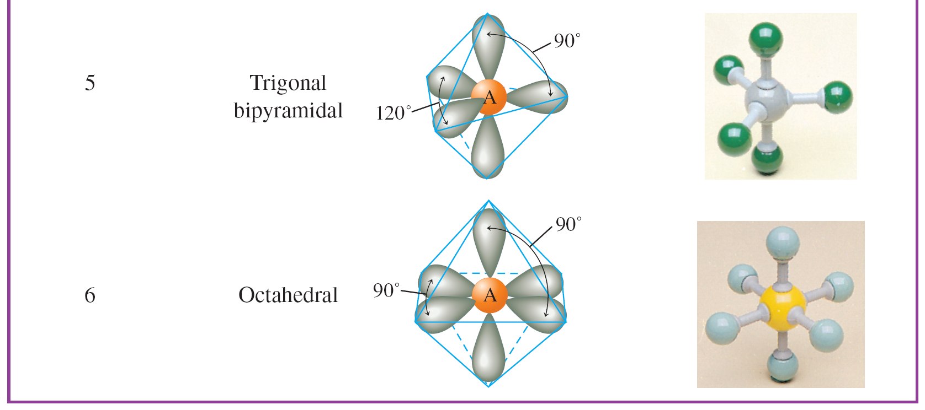
Arrangements of Electron Pairs Around an Atom Yielding Minimum Repulsion

Slide 66
Structures of Molecules That Have Four Electron Pairs Around the Central Atom

Slide 67
Structures of Molecules with Five Electron Pairs Around the Central Atom

Slide 68
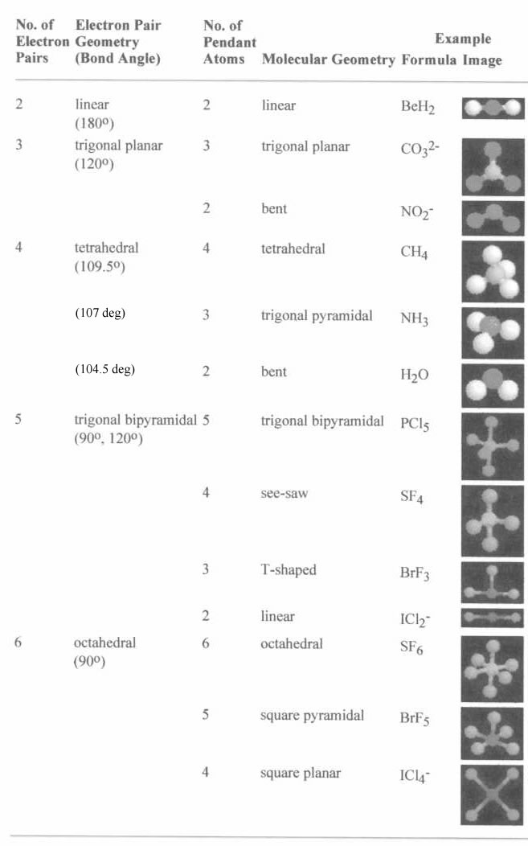
Valence shell electron pair repulsion (VSEPR) model:
Predict the geometry of the molecule from the electrostatic repulsions between the electron (bonding and nonbonding) pairs.
This chart is NOT provided on the AP exam!

Slide 69
Concept Check
Determine the shape for each of the following molecules, and include bond angles:
HCN
PH₃
SF₄
HCN – linear, 180º
PH₃ – trigonal pyramid, 109.5º (107º)
SF₄ – see saw, 90º, 120º
Notes:
HCN – linear, 180º
PH₃ – trigonal pyramid, 107º
SF₄ – see saw, 90º, 120º

Slide 70
Concept Check
Determine the shape for each of the following molecules, and include bond angles:
O₃
KrF₄
O₃ – bent, 120º
KrF₄ – square planar, 90º, 180º
Notes:
O₃ – bent, 120º
KrF₄ – square planar, 90º, 180º

